Slide 1


Water Stories
Story Writing
Competition
Story writing competition 2021
Michaela Mahlberg & David M. Hannah
@MichaMahlberg @freshwaterflows

Slide 2
What are stories for?
Telling a story is a way of understanding the world.
Stories help us make sense of the world.
Stories can change the world.
Here is a short video on the power of stories:
https://www.bbc.co.uk/ideas/videos/how-stories-shape-our-minds/p07h9t70

Slide 3
Can you think of examples of ‘water’ in stories? What are these stories about?

Slide 4
Can you think of examples of ‘water’ in stories?

Slide 5
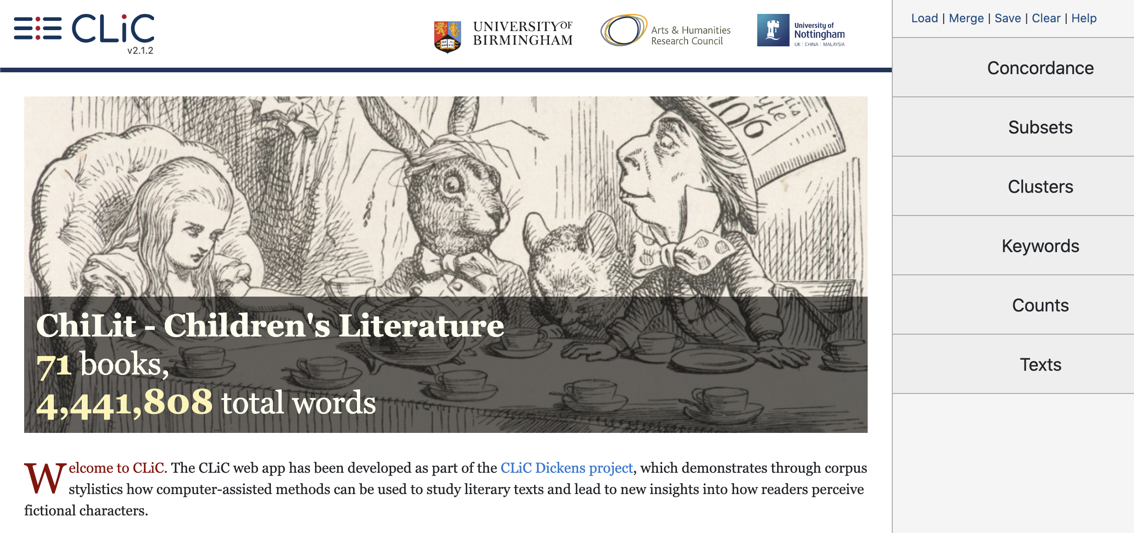
Let’s look at the word water in a whole bunch of stories!
You can access a collection of classic children’s books (e.g. Alice in Wonderland, Black Beauty, The Jungle Book) with CLiC:
https://clic.bham.ac.uk/
For this activity there is also a handout to download from the Water Stories page.

Slide 6
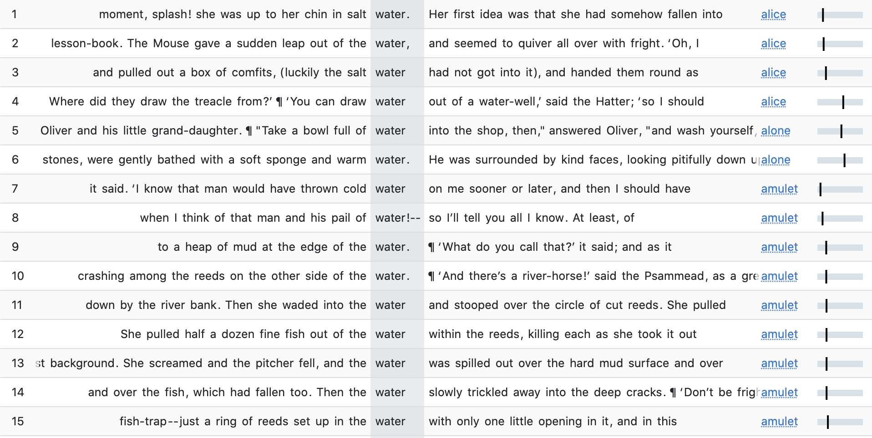
A concordance lists all the occurrences of the word water in a selection of texts.

Slide 7
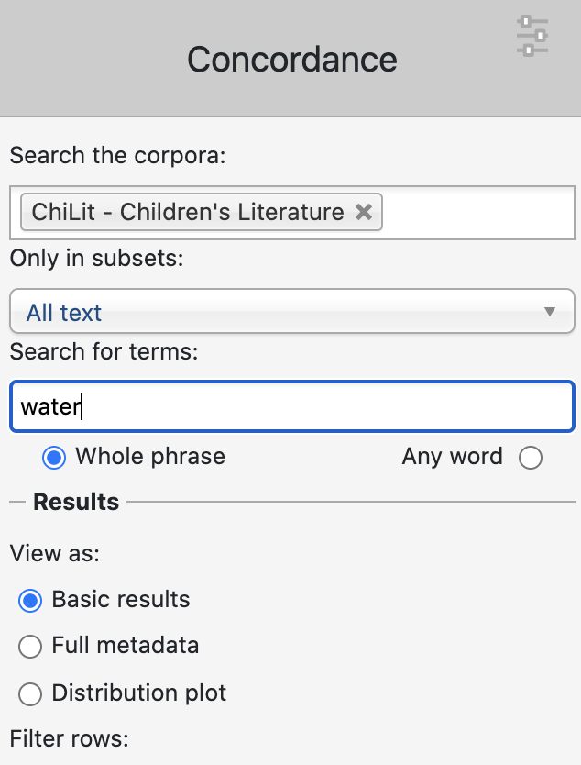
To run a concordance follow 3 steps
1. Go to the concordance tab
2. Select ‘ChiLit’ – a corpus of 19th century children’s literature
3. Put ‘water’ into the search box, and hit RETURN

Slide 8
A concordance lists all the occurrences of the word water in a selection of texts.
You can sort the concordance lines in various ways. Here they are sorted by the texts they come from

Slide 9
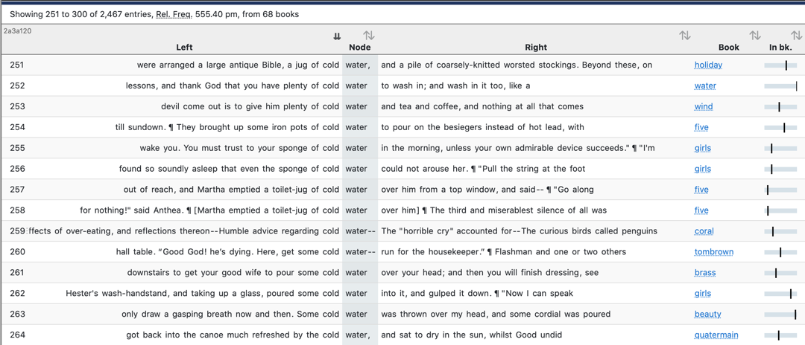
You can order the lines alphabetically on the left or or on the right by clicking on these arrows.
Look at the different adjectives in front of water. In the example cold shows water is used to wash in (line 252), it is used to wake people up (line 256), it revives people (line 260) and it is refreshing (line 264). Also look at other constructions around water and describe examples of different types of situations where water is referred to.

Slide 10
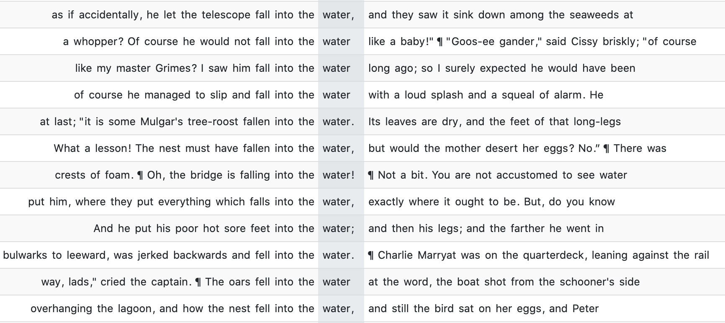
Some examples of water in stories:
People use water to drink, wash, throw over other people
Water is part of the environment / the settings and helps to describe locations, as in … across the water …, … by the water …
There’s quite a bit of ‘falling
into the water’, too.

Slide 11
Let’s think of stories!
Watch our video https://youtu.be/GwzZsMbaM3g
What does it mean if there is too much, too little, too polluted water? Can you imagine story lines that address these situations?
2) Can you think of water stories across different genres?
  Mystery and crime stories – Why is there too little water? Where does the water pollution come from? Who controls water?
  Science fiction and dystopias – What inventions might shape the future of water?
  Historical fiction – Are there water stories for the place you live?
  Adventure stories – Can you think of explorers and their quests?

Slide 12
What does a story need?
A story is a sequence of events with people (or animals or other actors) who do things and experience the events of the story.
There are culturally shaped patterns of how stories can unfold. Very common is the ‘problem-solution’ pattern. It has these elements:
Situation: Sets the scene, introduces characters
Problem: Within the situation there is a problem that requires a response
Response / solution: What’s done to tackle the problem?
Result / evaluation: Is the problem solved? How does the story come to an end?

Slide 13
Planning your story
Situation:
Problem:
Response / solution:
Result / evaluation:
Don’t forget to add a title for your story!

Slide 14
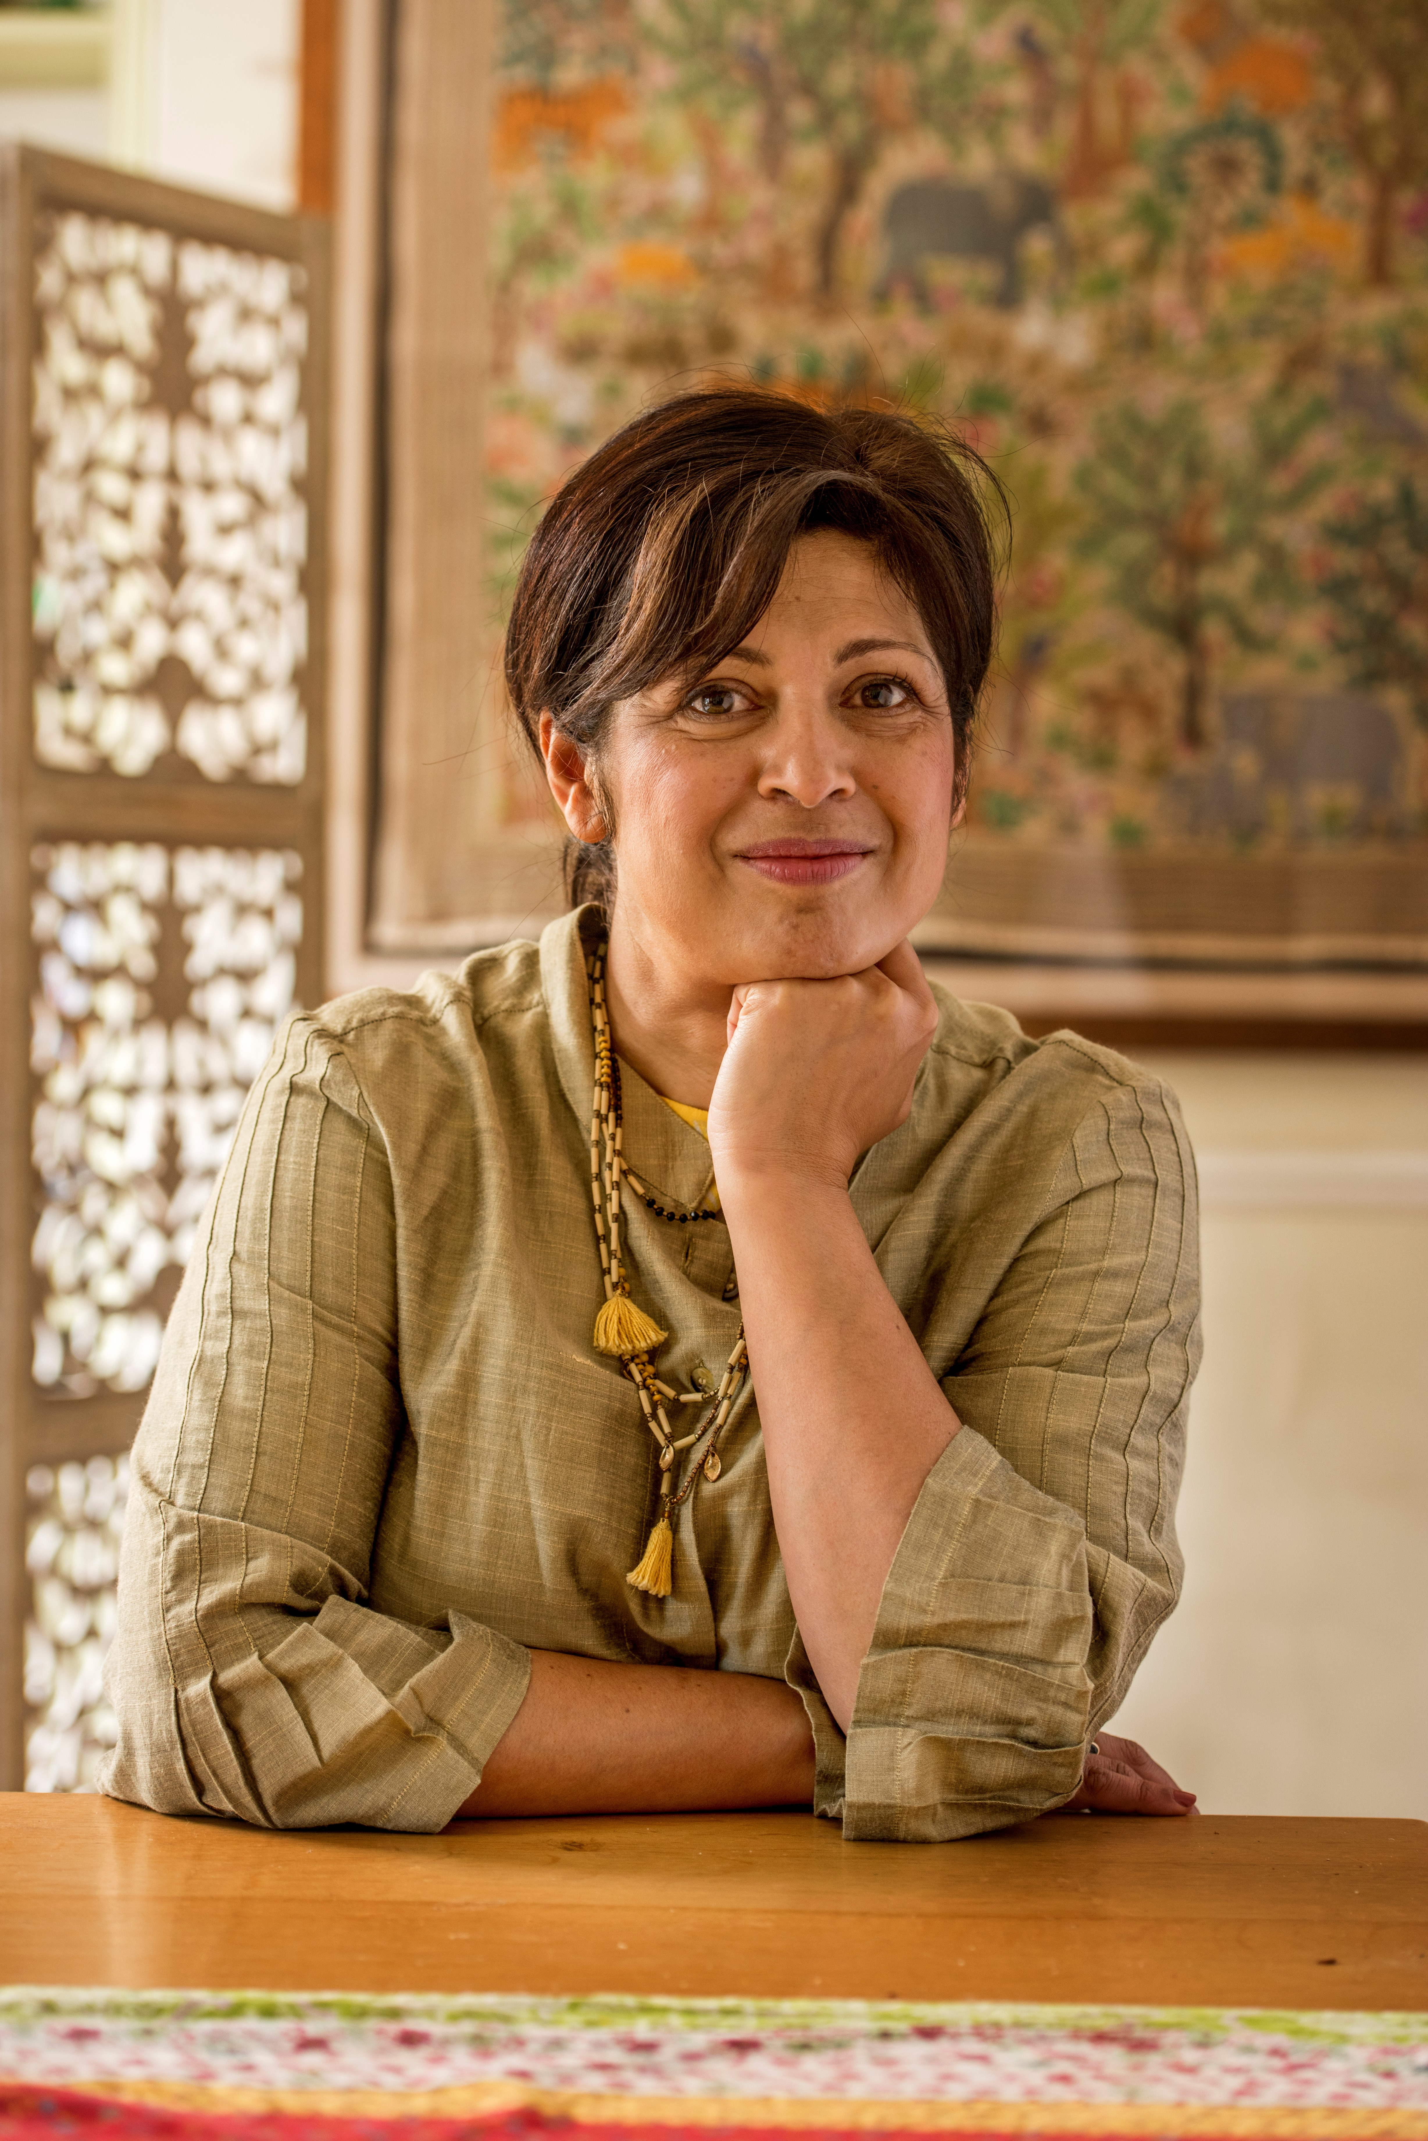
Getting inspiration from a professional writer
Bestselling author Sita Brahmachari will be sharing short inspirations over the coming weeks.
Check out the Water Stories webpage regularly!
Sita is passionate about championing inclusiveness, was the 2015 Booktrust Writer in Residence and recipient of an honour from the International Board of Books for Young People. She’s the current Writer in Residence at Islington Centre for Refugees and Migrants, as well as an Amnesty International ambassador.
Among her books are the World Book Day title The River Whale and Where the River Runs Gold.
Sita will be head judge on the panel who will choose the winner of the competition.

Slide 15
Key competition information:
Deadline for submission of the story: Monday 29th November
Winners will be announced: January 2022
Story length: 500 - 750 words
The competition is open to participants aged 9 to 14 years old from across the UK
Open to individual and school submissions, but each writer can only take part once
Please submit via the online submission form, it will open on the webpage later in September
Also check the webpage for information on judging criteria

Slide 16
For more visit https://literacytrust.org.uk/water-stories
Story Writing
Competition

