Slide 1
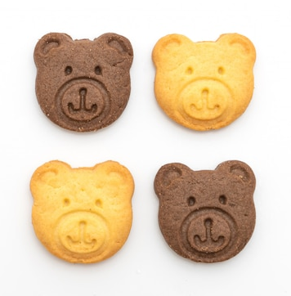
Bear biscuits
Preparation time: 20 minutes
Cooking time: 8-12 minutes
Serves: 12 biscuits
What you will need
Mixing bowl
Wooden spoon
Greaseproof paper
Baking tray
Rolling pin
Biscuit cutter
Wire rack
50g unsalted butter
50g caster sugar
1 small egg
1 tsp vanilla extract
138g plain flour
100g icing sugar
2 tbsp water
1-2 drops food colouring
Sprinkles/Sweets/Icing pens
Preheat the oven to 190C/170C Fan
Put greaseproof paper on a baking tray.
Mix the butter and sugar together in a bowl. Whisk in the egg and vanilla extract.
Stir in the flour and bring together to form a dough.
Roll the dough out on a lightly floured work surface.
Using biscuit cutters, cut the biscuits and place onto the baking tray.
Bake for 8-12 minutes, or until pale golden-brown. Set aside to firm up for 2 minutes, then transfer to cool on a wire rack.
For the icing, sift the icing sugar into a large mixing bowl and stir in enough water to create a smooth mixture.
Stir in the food colouring.
Carefully spread the icing onto the biscuits using a spoon and decorate.

Slide 2
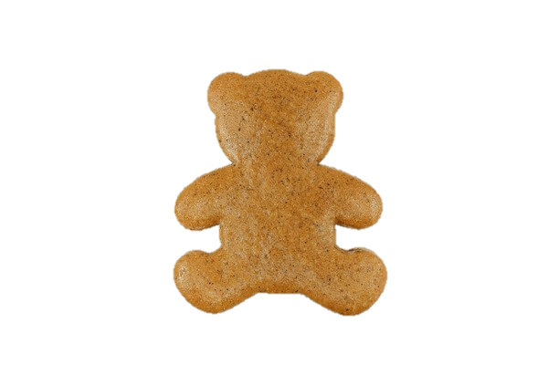












Buttery bear biscuits
Too yummy!
SO SWEET!
What you will need
Get ready to bake a batch of "just right" biscuits, inspired by the Three Bears! Whether you're a big bear, little bear, or somewhere in between, these buttery treats are sure to make everyone's mouth water.
Time needed: 20 minutes Cooking time: 8-12 minutes Serves: 12 biscuits
Bear shaped
Method
Preheat the oven to 190C/170C Fan/Gas 5.
Line a baking tray with greaseproof paper.
Cream the butter and sugar together in a bowl.
Beat in the egg and vanilla extract, a little at a time, until well combined.
Stir in the flour and bring together to form a dough.
Roll the dough out on a lightly floured work surface to a thickness of 1cm.
Using biscuit cutters, cut biscuits out of the dough into a bear shape and carefully place onto the baking tray.
Bake for 8-12 minutes, or until pale golden-brown. Set aside to firm up for 2 minutes, then transfer to cool on a wire rack.
For the icing, sift the icing sugar into a large mixing bowl and stir in enough water to create a smooth mixture.
Stir in the food colouring.
Carefully spread the icing onto the biscuits using a spoon, decorate and set aside until the icing hardens.
Just right…
Ingredients
1
50g
50g
1tsp Vanilla
138g
To decorate
2tbsp
1-2 drops
100g
Icing

