Slide 1
Senior National Reading Champions Quiz 2026
School Toolkit
ALCS

Slide 2

Getting involved
Welcome to The Senior National Reading Champions Quiz 2026!
Thank you for joining us to support a reading for pleasure culture in your school and celebrate your enthusiastic readers.
As you know, reading for pleasure brings so many benefits – confidence, wellbeing, academic achievement, increased empathy – and sharing exciting news and information about your school’s involvement in the quiz is a great way to spark the interest and ignite the pride of the whole school community.
This toolkit includes some ideas of how you can celebrate taking part in the quiz and your commitment to supporting your pupils to read for pleasure.
ALCS

Slide 3
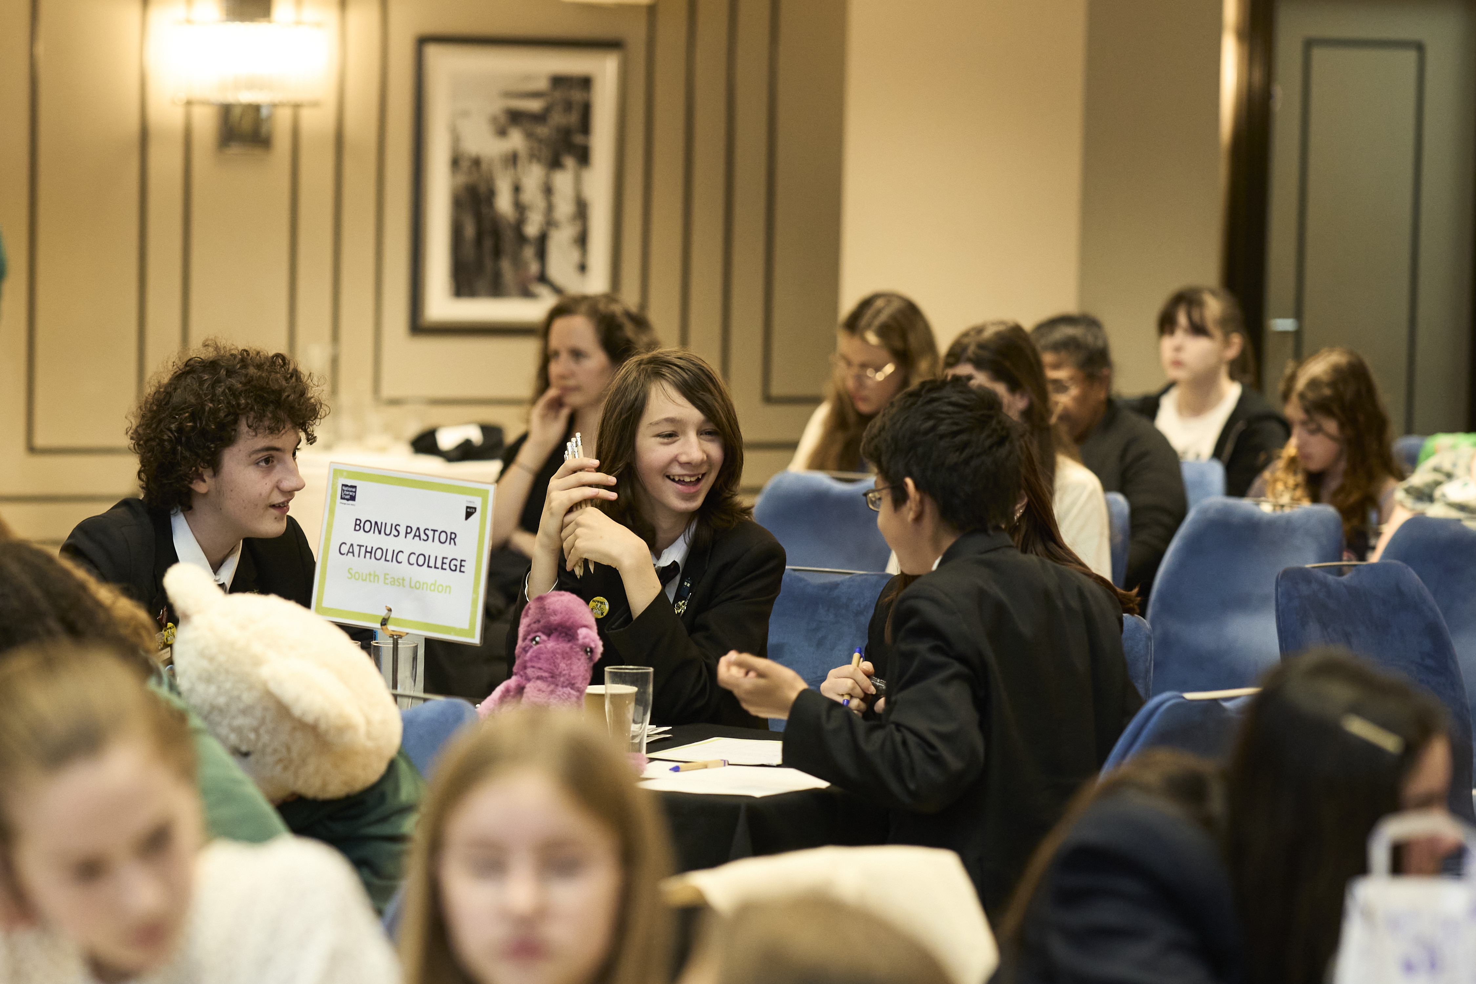
Social Media
ALCS

Slide 4
Creating social media content
Accounts to tag
X/Twitter: @literacy_trust and @alcs_uk
Instagram: @literacy_trust and @alcs_uk
Facebook: @nationalliteracytrust and @ALCSUK
LinkedIn: @National-Literacy-Trust and @the-authors-licensing-&-collecting-society
If your school or school library has social media channels, we’d encourage you to share your team’s journey throughout the quiz. We would love to see every stage of pupils preparing and taking part in the heats (and maybe even the final!)
Don’t forget to tag us so we can see all your amazing photos and posts.
The next few slides have suggested posts but please feel free to come up with your own ideas.
Hashtags you can include
#NRCQuiz2026
#GrowAGenerationOfReaders
ALCS

Slide 5
Suggested text
At XXX school, we know that when children enjoy reading their learning, wellbeing and confidence benefit. That’s why we’re participating in the Senior National Reading Champions Quiz 2026 #NRCQuiz2026 #GrowAGenerationofReaders
Reading for pleasure improves children’s wellbeing, confidence, and their reading skills, helping them to learn and be happier. It can really change lives! That is why we’re so excited to take part in the Senior National Reading Champions Quiz with @literacy_trust to celebrate and encourage our pupils on their reading journeys.
[XX pupil first names of the team members] are representing us in the [XX region heat (or final)] today and we can’t wait to see them shine with their reading knowledge! Good luck from everyone at [XX school] #NRCQuiz2026
Whether it’s cheering on our #NRCQuiz2026 team or diving into stories in class, reading is a passion we all share at XXX school. Good luck from the whole school to our team taking part in the @literacy_trust quiz today!
ALCS

Slide 6
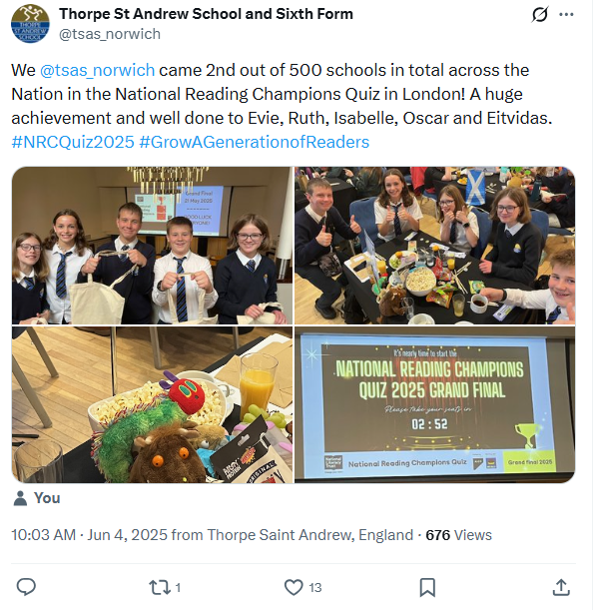
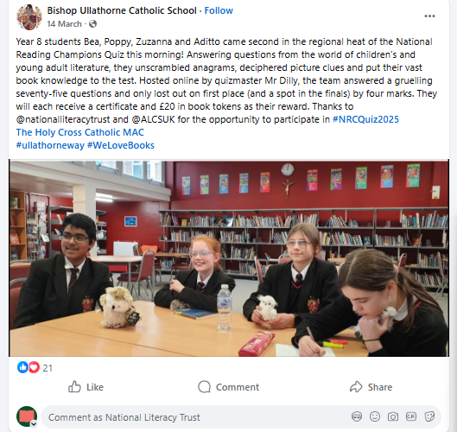
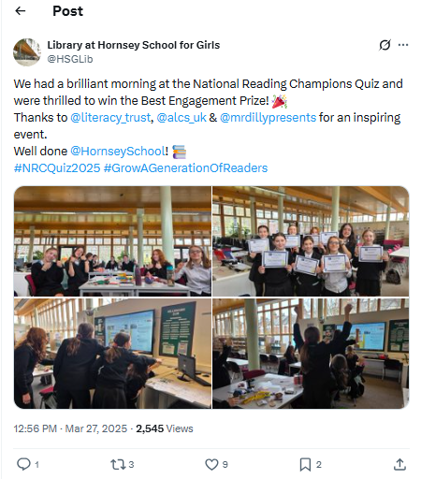
Images
Whether it’s a team introduction post, a snapshot from your heat preparation or a photo reaction to your results – we can’t wait to see your amazing photos from your team’s journey in this quiz. Here are some of our favourite examples from last year’s social media content…
We’d also love to see videos from your team’s reaction to finding out they are attending the final, their journey to London and/or their experience on the day at the grand final.
ALCS

Slide 7
Creative Ideas
Phase 1: Team introductions
Idea: A video of the team members describing what reading means to them OR sharing what their favourite book is
Suggested caption: Reading can change lives! We're so excited for our #NRCQuiz2026 team to compete and celebrate the benefits of reading. Here is what reading means to our pupils/Here are the team’s top reads.
Phase 3: Grand final
Idea: Video or written quotes from each team member about their favourite part of the day after the grand final OR a ‘day in the life at the Senior National Reading Champions Quiz final’ style video with clips from the day
Suggested caption: Our wonderful #NRCQuiz2026 team had the best time today at the grand final. Seeing so many passionate young people in one place shows the inspiring power of books and reading. Thank you @literacy_trust and @alcs_uk for helping us to #GrowAGenerationOfReaders
Alt suggested caption: That’s a wrap on the Senior National Reading Champions Quiz 2026 and we’re so proud of our team of star readers. Reading has the power to connect people and we saw that today at the #NRCQuiz2026 final with @literacy_trust and @alcs_uk
Phase 2: Regional heats
Idea: Video/photos of the team preparing/ practising for the quiz OR quotes from each team member after the heat about their result
Suggested caption: Taking part in the Senior National Reading Champions Quiz has strengthened their teamwork. From wellbeing to confidence, reading has so many benefits and we’re proud of our star readers #NRCQuiz2026
ALCS

Slide 8
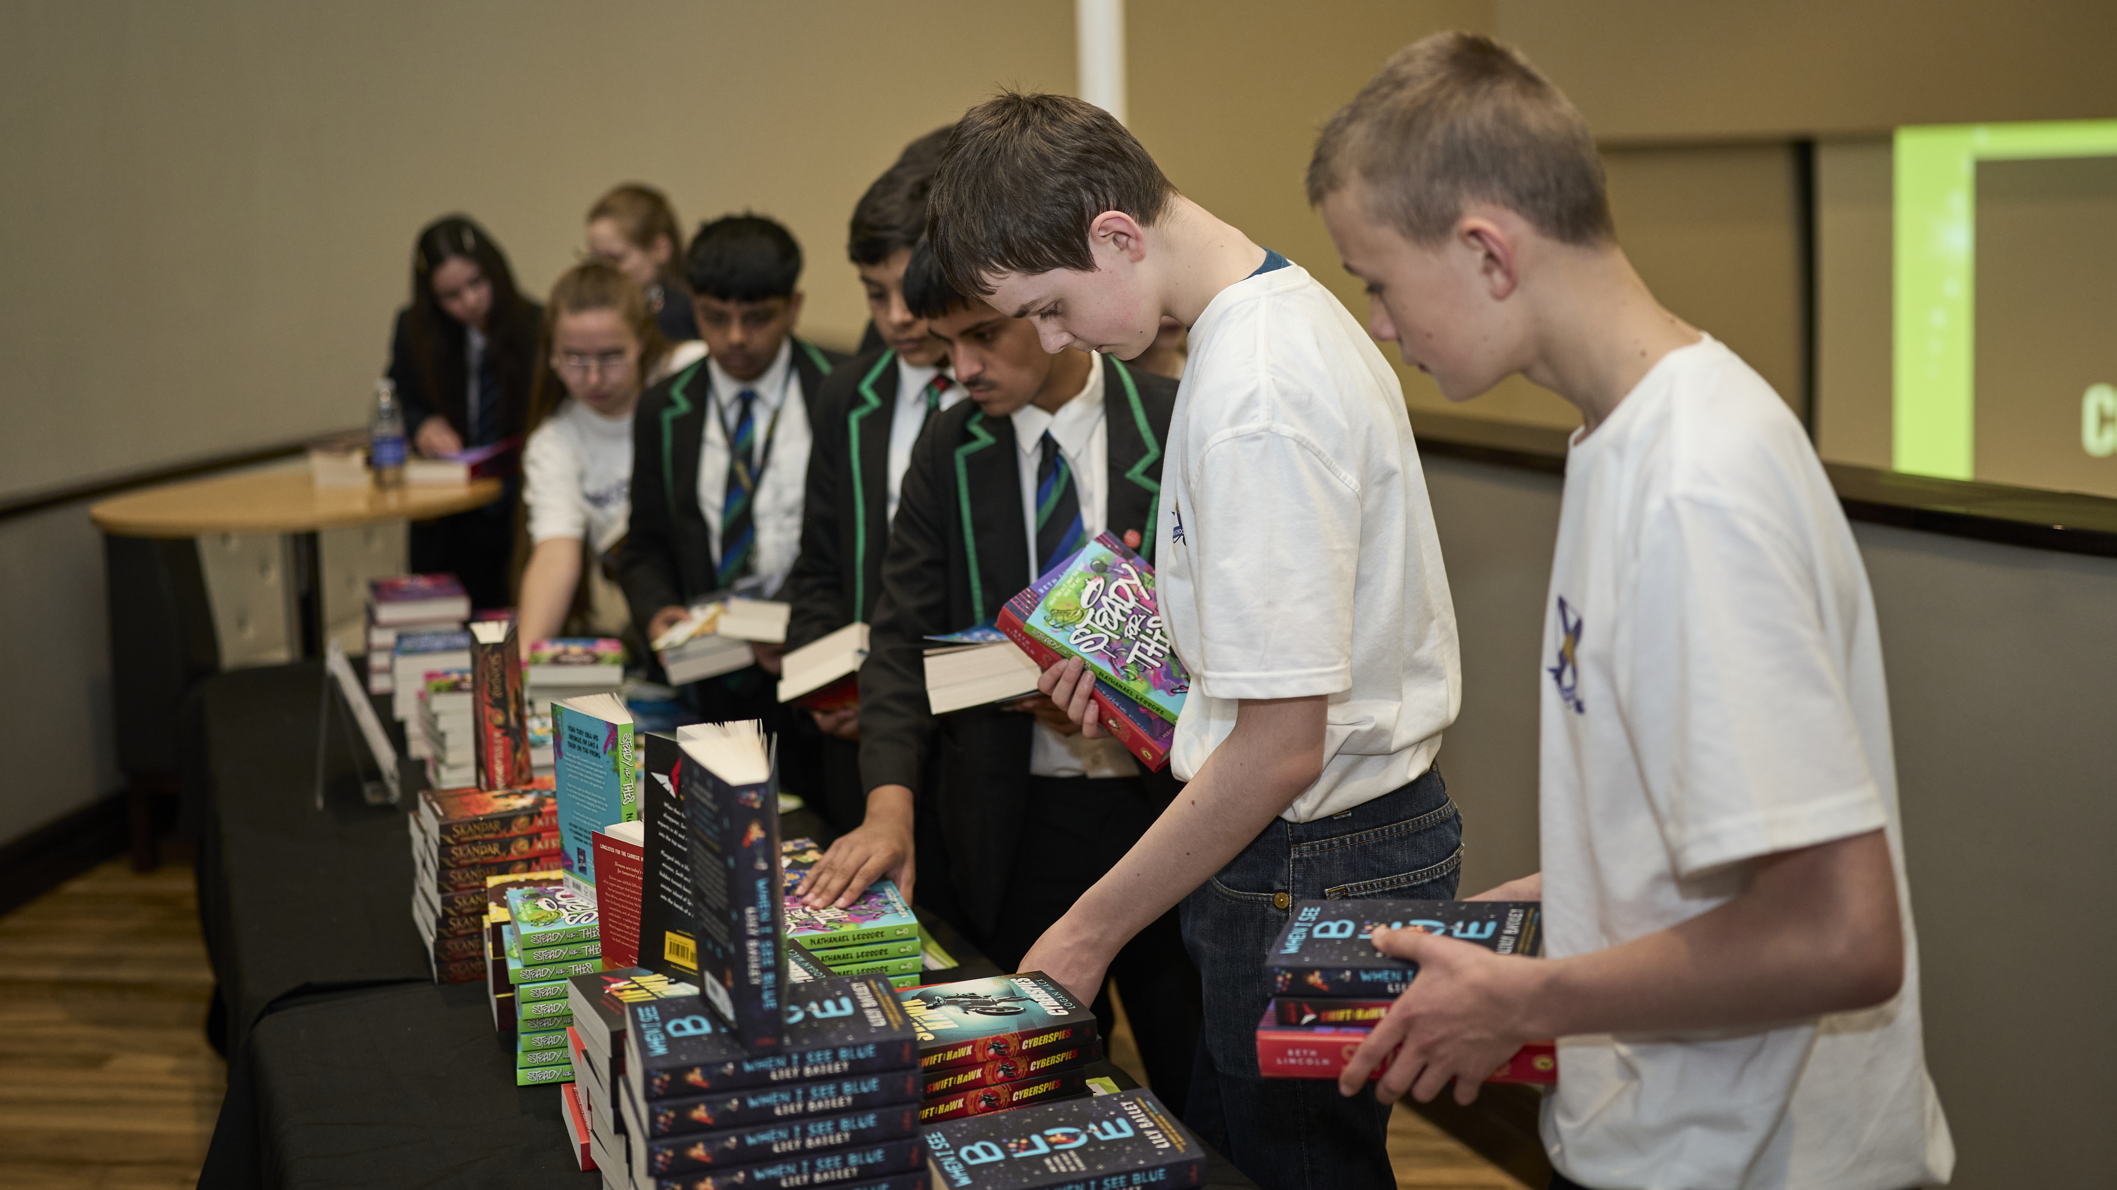
Local Media
ALCS

Slide 9
Pitching a story to local news
You might want to reach out to your local media outlet(s), who may be looking for positive local interest stories, to share your team’s story about their involvement in the quiz and why your school has taken part, particularly if your team win their regional heat and make it to the grand final.
This toolkit includes a full written press release that you can use by filling in the details about your school and then emailing it to local journalists.
Tips for pitching your news story:
Research the best person to contact at the outlet – you can find them on the news outlet’s website staff pages or on social media
Include any relevant background information to your school
Add in quotes from pupils and teachers/librarians in the gaps provided in the press release to add more colour to the story
Don’t be disheartened if you don’t hear back, journalists are very busy, and your pupils will be celebrated by the National Literacy Trust and within your school community!
ALCS

Slide 10
Press release
For immediate release
Star readers at [XX School] in [XX] invited to London final after winning regional heat of senior national reading quiz
Pupils from [XX School] are named [region]’s top readers after winning the regional heats of the Senior National Reading Champions Quiz, a huge national reading quiz run by the National Literacy Trust to celebrate the country’s star readers and spread the important of reading for enjoyment.
The team of four pupils went head-to-head with peers from [XX number of] schools in the area during the heats on [date] in a series of tough rounds which tested their knowledge of popular children’s books and authors.
After a close heat, the team came out on top and will be heading to London on Wednesday 20 May to come face-to-face with every region’s top team to battle it out in the grand final, with the aim to be crowned the Senior National Reading Champions of 2026.
The competition, which is in its fifth year, is run by the National Literacy Trust and funded by the Author’s Licensing and Collecting Society (ALCS) and celebrates keen, young readers and champions the important role of teachers and school librarians in promoting reading for pleasure.
It comes after National Literacy Trust research revealed that reading for pleasure has huge benefits to children’s wellbeing, empathy, confidence and academic achievement – but only 1 in 3 children and young people enjoy reading in their free time, meaning many are missing out.
The quiz aims to celebrate young people aged 10-14 for their interest in reading and connect them with other readers their age from across the country, to reinforce the benefits of reading for pleasure.
[XX school] were named regional champions after getting X out of X questions correct and showcasing their skilful ability to identify the characters, authors and titles across a breadth of children’s literature. They really shone in [example of most successful round, e.g. when they had to put their heads together to solve brainteasers].
Now they have the chance of competing for the grand trophy other exciting prizes if they win the country’s top spot on 20 May, with second and third place finalists also in the running for prizes.
[CONTINUED ->]
ALCS

Slide 11
[Pupil name], pupil from [X winning School] said: [sample quote] : “I am over the moon, this is such a big achievement for me. I’ve always loved stories, their characters and how we can escape into their worlds, but I never thought that was something I could win a prize for. The Quiz has made that possible and given me a push towards embracing my love of books, and I feel really proud.”
[Librarian / teacher name], [job title], from [X School], said: [sample quote]: “This has been a great opportunity for the pupils, it’s been a massive boost to their confidence to take part in a national competition and to win the regional heat. It’s been so great to see their progress, how they’ve prepared and worked together on this Quiz. They’ve exceeded all expectations!”
Henrietta Roberts, Senior Project Manager of the Senior National Reading Champions Quiz, said: “We are so thrilled to run the Senior National Reading Champions Quiz to celebrate young readers across the UK. There is an amazing wealth of literature out there for children to explore and we hope to motivate them to read as widely as possible, to feel proud of their reading knowledge and to experience all the great benefits of reading for pleasure. We wish the best of luck to all the schools competing in the final and look forward to crowning the Senior National Reading Quiz Champions of 2026!”
For more information on the National Reading Champions Quiz visit: www.literacytrust.org.uk/programmes/reading-champions/national-reading-champions-quiz/
-ENDS-
Notes to editors
About the National Literacy Trust
The National Literacy Trust is an independent charity that empowers children, young people and adults with the literacy skills they need to succeed. Reading, writing, speaking and listening skills give you the tools to get the most out of life, and the power to shape your future. For over 30 years the National Literacy Trust has continued to support schools, families and communities on a local and national level to help people change their stories.
literacytrust.org.uk
About ALCS
The Authors’ Licensing and Collecting Society (ALCS) is a not-for-profit organisation started by writers for the benefit of all types of writers. Owned by its members, ALCS collects money due for secondary uses of writers’ work. It is designed to support authors and their creativity, ensure they receive fair payment and see their rights are respected. It promotes and teaches the principles of copyright and campaigns for a fair deal. It represents over 110,000 members, and since 1977 has paid over £500 million to writers (alcs.co.uk).
ALCS

Slide 12
Student Reporting
ALCS

Slide 13
Student reporter pack
To help engage pupils who aren’t on the quiz team and involve everyone, you might want to encourage them to write a report for a blog, newsletter, school website or even your social media channels about the quiz and the team’s journey.
Here are some tips:
Have them interview the team members, teachers and librarians involved
Suggested questions: What kept you calm in the pressure of the regional heats? How did your team work together and prepare? How do you feel the experience affected your books knowledge and interest in reading?
Encourage pupils to think about the human-interest angle of the story and who their audience is, and what they’ll be most interested in (e.g. parents, other pupils etc)
Include photos of the team, such as them preparing and taking part in the quiz
Consider having pupils run a live blog covering the events of the quiz. You can find lots of information online about setting up a live blog
Alternatively, they can keep the school community and families updated by posting regular updates on your school’s Facebook or X/Twitter account
We would love to see their Senior National Reading Champions Quiz report and content, so please take a photo and tag us or email us the link.
ALCS

Slide 14
If you have any questions, please contact: NRCQ@literacytrust.org.uk Happy Quizzing!
ALCS

